Slide 1



Introducing KU BOLT BROWSER
Ku bolt browser is the entirely new Windows c# base browser. Fast and fluid, and perfect for windows platfrom. Ku bolt browser lets you see the web the way you’re meant to see it.
Objectives
Get started
KU BOLT BROWSER

Slide 2



Contents
1.C# base fast and light browser
2.Direct search somthing to Google & Bing
3.Built with the letsest windows and a Awesomium SDK
4.Links Bar facilities
5.History view option
6.Favorite your wanted web easyly
7.Search and seperate link bar intregrated
8.New tab facilities included.
9.Go a web site browse it with refresh facilities.
10.Cut, Copy, Paste, Select All any kinds of text from the bolt browser.
11.Finally build with the sequirity and coustomer privacy.
Features of the web browser
Return home
Get started
KU BOLT BROWSER

Slide 3

Experience a fast and fluid web
In c# language platform.
1
Fast, fluid
3
4
5

Slide 4
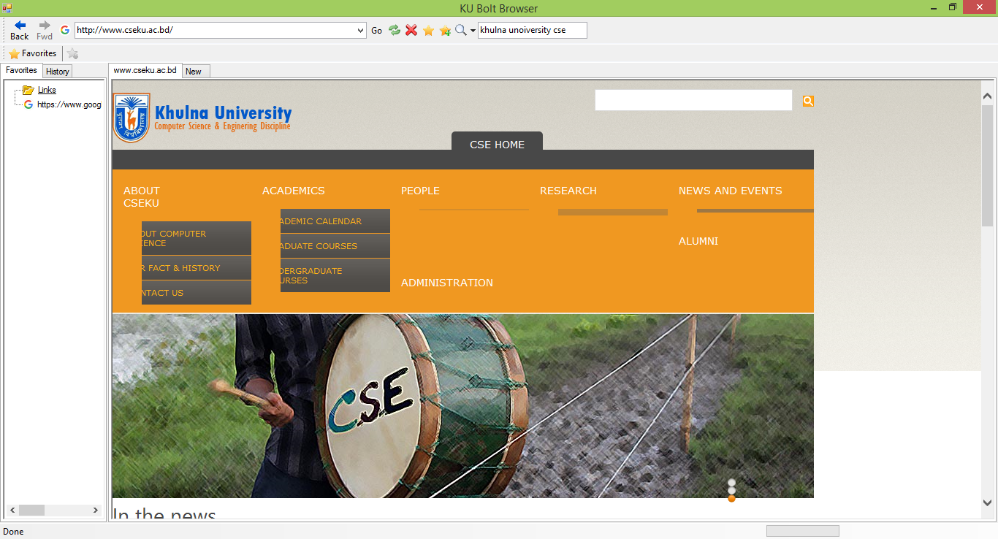
Nice user interface with Easy and convinent GUI.
Pin websites to the Start screen, so you can quickly access your favorite websites right from the Start.
1
Fast, fluid
3
4
5

Slide 5
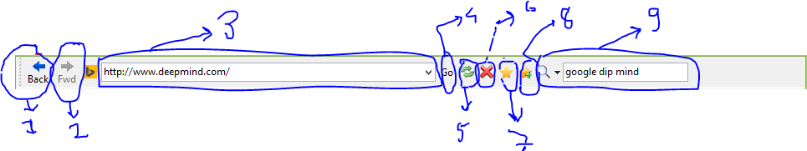
Experience the new, fast and fluid Windows c# platform base browser.
1.Back button
2.Forward button
3.Direst link bar
4.Go pess button
5.Refresh bottun
6.Stop button
7.Favorite showing button
8.Make favorite button
9.Direct Google & Bing search button
1
Fast, fluid
3
4
5

Slide 6
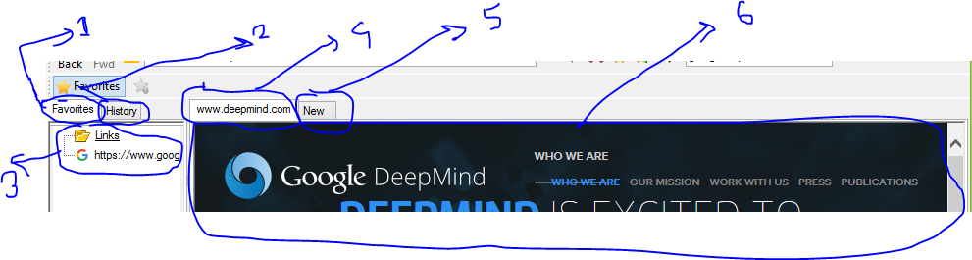
Experience new, fast and fluid Windows c# platform base browser.
1.Favorite pannel
2.History pannel
3.Saved link showing bar
4.Address of the web site
5.New tab creation button
6.Required web site interface
1
Fast, fluid
3
4
5

Slide 7
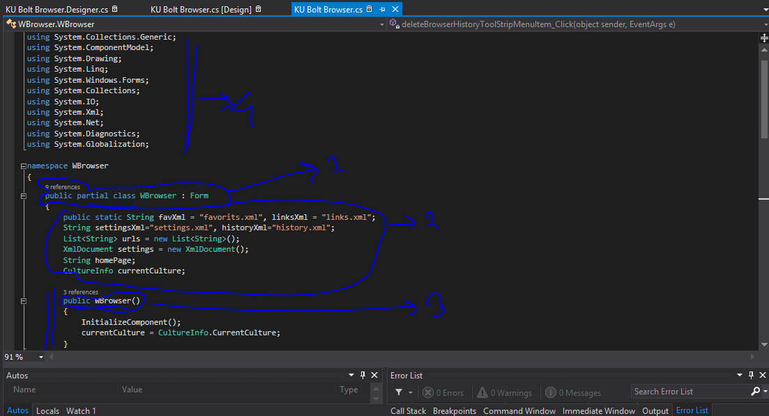
Ku bolt browser is fully open source now Inside of the ku bolt browser.
1.Initialization of the full windows form.
2.Making xml and preparing the design.
3.Starting the web browser calss on the code.
4.Including the required hedder files.
1
Fast, fluid
3
4
5

Slide 8
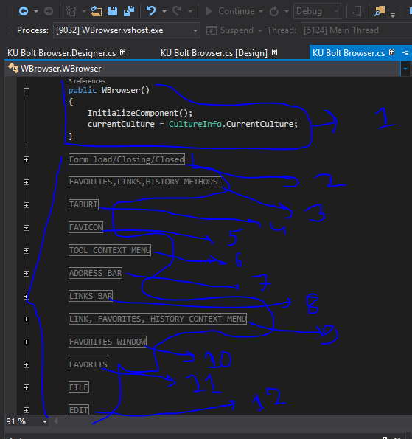
Ku bolt browser is fully open source now Inside of the ku bolt browser.
1.Calling all the method to the parrent metod to started the ku bolt browser.
2.From load method.
3.Favorite history method.
4.Url method.
5.Favorite icon method.
6.Tool contex menue.
7.Address bar method.
8.Link abr method.
9.All three intregated.
10.Favorite windows method.
11.Favorite finish metod.
12.Edit method.
1
Fast, fluid
3
4
5

Slide 9
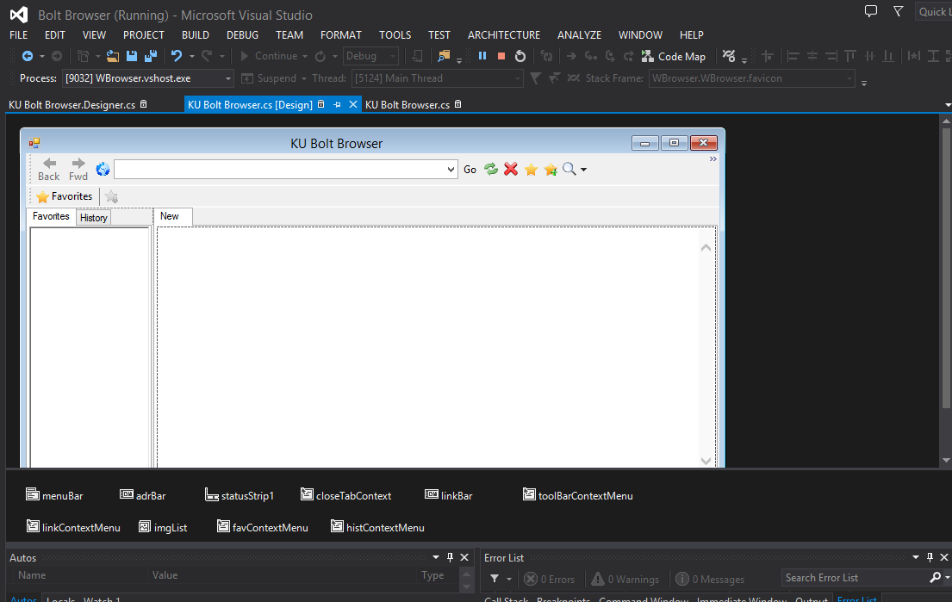
Ku bolt browser is fully open source now Inside Design of the ku bolt browser.
>>>Inside of the design of the KU BOLT BROWSER
1
Fast, fluid
3
4
5

Slide 10
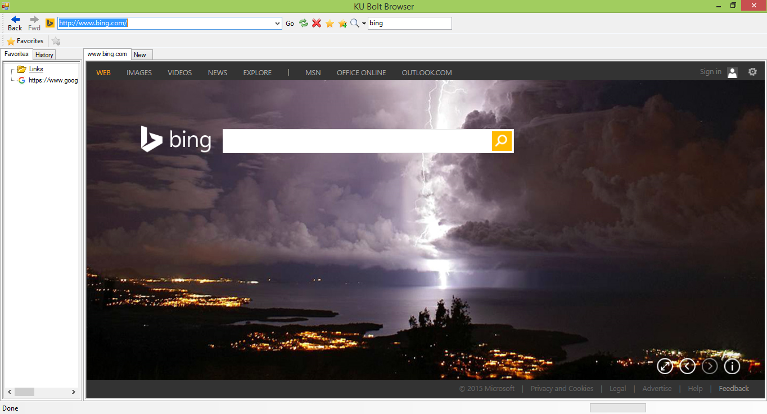
Ku bolt browser in full screen.
Got fully functinal with the full screen feature of the web browser
1
2
Full web
4
5

Slide 11
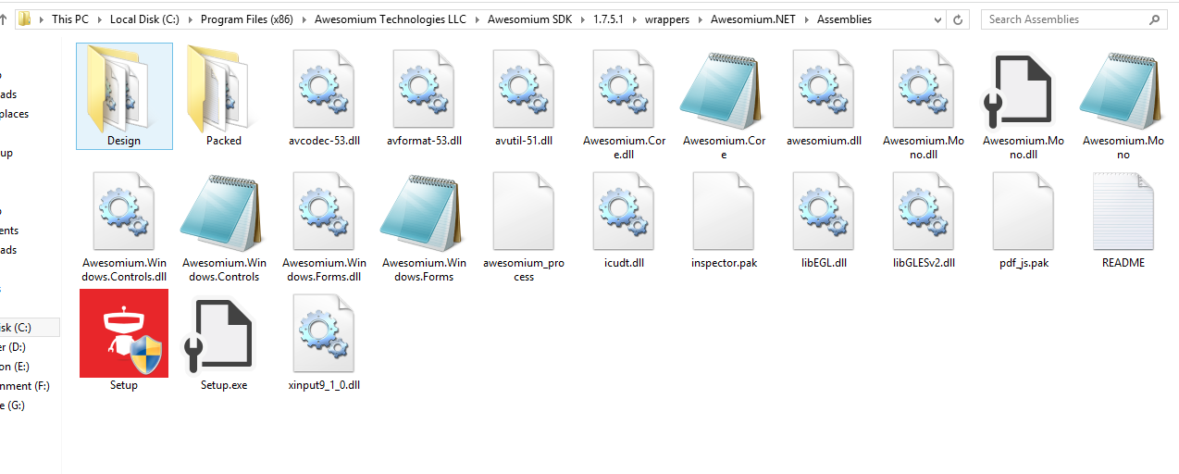

Web, with support for Awesomium SDK® and HTML5.
While many websites require Adobe® Flash® to view the content, some tablet browsers do not support Flash capabilities.
Ku bolt browser supports both Adobe® Flash® and modern web standards like HTML5, so websites meant to be easy to browse.
1
2
Full web
4
5

Slide 12

Thanks slide goes end here ☺
Head of the software architact: MD. SHAHIDUL ISLAM
1
2
Full web
4
5

